Slide 1
The Costs of Production
CHAPTER 13
Notes:
N. Gregory Mankiw Principles Of Economics Eight Edition

Slide 2
What are Costs?, Part 1
Industrial organization
The study of how firms’ decisions about prices and quantities depend on the market conditions they face
Assumption
The goal of a firm is to maximize profit
Profit
Total revenue minus total cost

Slide 3
What are Costs?, Part 2
Total revenue, TR = P × Q
Amount a firm receives for the sale of its output
Quantity of output the firm produces times the price at which it sells its output
Total cost, TC
Market value of the inputs a firm uses in production

Slide 4
What are Costs?, Part 3
Costs as opportunity costs
The cost of something is what you give up to get it
Firm’s cost of production
Include all the opportunity costs of making its output of goods and services
Explicit costs
Implicit costs

Slide 5
What are Costs?, Part 4
Explicit costs
Input costs that require an outlay of money by the firm
Implicit costs
Input costs that do not require an outlay of money by the firm
Ignored by accountants
Total costs
= Explicit costs + Implicit costs

Slide 6
What are Costs?, Part 5
The cost of financial capital as an opportunity cost
Implicit cost
Interest income not earned on financial capital
Owned as saving
Invested in business
Not shown as cost by an accountant

Slide 7
What are Costs?, Part 6
Economic profit
Total revenue minus total cost
Total costs includes both explicit and implicit costs
Accounting profit
Total revenue minus total explicit cost
Usually larger than economic profit

Slide 8
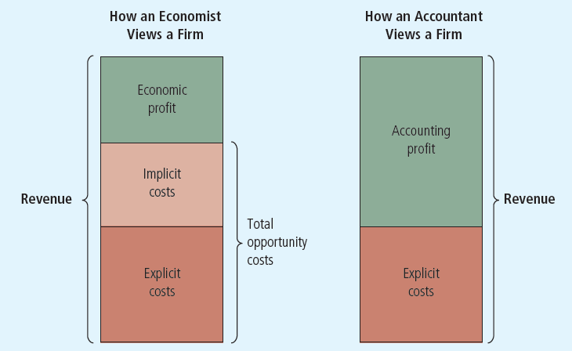
Figure 1 Economists versus Accountants
Economists include all opportunity costs when analyzing a firm, whereas accountants measure only explicit costs. Therefore, economic profit is smaller than accounting profit.

Slide 9
Production and Costs, Part 1
Production function
Relationship between
Quantity of inputs used to make a good
And the quantity of output of that good
Gets flatter as production rises
Marginal product
Increase in output that arises from an additional unit of input
Slope of the production function

Slide 10
Table 1 A Production Function and Total Cost: Caroline’s Cookie Factory
(1) Number of Workers | (2) Output (quantity of cookies produced per hour) | (3) Marginal Product of Labor | (4) Cost of Factory | (5) Cost of Workers | (6) Total Cost of Inputs (cost of factory plus cost of workers)
0 | 0 | Empty cell | $30 | $0 | $30
1 | 50 | 50 | 30 | 10 | 40
2 | 90 | 40 | 30 | 20 | 50
3 | 120 | 30 | 30 | 30 | 60
4 | 140 | 20 | 30 | 40 | 70
5 | 150 | 10 | 30 | 50 | 80
6 | 155 | 5 | 30 | 60 | 90

Slide 11
Production and Costs, Part 2
Diminishing marginal product
Marginal product of an input declines as the quantity of the input increases
Production function gets flatter as more inputs are being used
The slope of the production function decreases

Slide 12
Production and Costs, Part 3
Total-cost curve
Relationship between quantity produced and total costs
Gets steeper as the amount produced rises
Diminishing marginal product
Producing one additional unit of output requires a lot of additional units of inputs: very costly

Slide 13
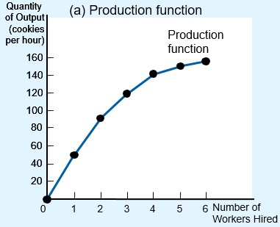
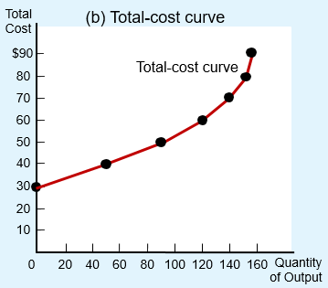
Figure 2 Caroline’s Production Function and Total-Cost Curve
The production function in panel (a) shows the relationship between the number of workers hired and the quantity of output produced. Here the number of workers hired (on the horizontal axis) is from column (1) in Table 1, and the quantity of output produced (on the vertical axis) is from column (2). The production function gets flatter as the number of workers increases, reflecting diminishing marginal product.
The total-cost curve in panel (b) shows the relationship between the quantity of output produced and total cost of production. Here the quantity of output produced (on the horizontal axis) is from column (2) in Table 1, and the total cost (on the vertical axis) is from column (6). The total-cost curve gets steeper as the quantity of output increases because of diminishing marginal product.

Slide 14
The Various Measures of Cost, Part 1
Fixed costs, FC
Costs that do not vary with the quantity of output produced
Variable costs, VC
Costs that vary with the quantity of output produced
Total cost, TC
= Fixed cost + Variable cost

Slide 15
The Various Measures of Cost, Part 2
Average fixed cost, AFC
Fixed cost divided by the quantity of output
Average variable cost, AVC
Variable cost divided by the quantity of output

Slide 16
Table 2 The Various Measures of Cost: Conrad’s Coffee Shop
(1) Output (cups of coffee per hour) | (2) Total Cost | (3) Fixed Cost | (4) Variable Cost | (5) Average Fixed Cost | (6) Average Variable Cost | (7) Average Total Cost | (8) Marginal Cost
0 | $3.00 | $3.00 | $0.00 | Empty cell | Empty cell | Empty cell | Empty cell
1 | 3.30 | 3.00 | 0.30 | $3.00 | $0.30 | $3.30 | $0.30
2 | 3.80 | 3.00 | 0.80 | 1.50 | 0.40 | 1.90 | 0.50
3 | 4.50 | 3.00 | 1.50 | 1.00 | 0.50 | 1.50 | 0.70
4 | 5.40 | 3.00 | 2.40 | 0.75 | 0.60 | 1.35 | 0.90
5 | 6.50 | 3.00 | 3.50 | 0.60 | 0.70 | 1.30 | 1.10
6 | 7.80 | 3.00 | 4.80 | 0.50 | 0.80 | 1.30 | 1.30
7 | 9.30 | 3.00 | 6.30 | 0.43 | 0.90 | 1.33 | 1.50
8 | 11.00 | 3.00 | 8.00 | 0.38 | 1.00 | 1.38 | 1.70
9 | 12.90 | 3.00 | 9.90 | 0.33 | 1.10 | 1.43 | 1.90
10 | 15.00 | 3.00 | 12.00 | 0.30 | 1.20 | 1.50 | 2.10

Slide 17
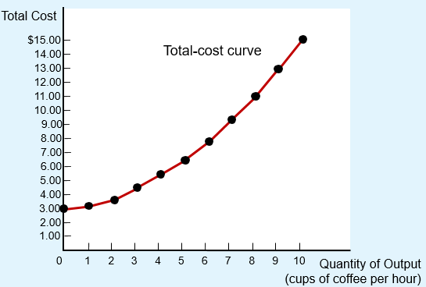
Figure 3 Conrad’s Total-Cost Curve
Here the quantity of output produced (on the horizontal axis) is from column (1) in Table 2, and the total cost (on the vertical axis) is from column (2). As in Figure 2, the total-cost curve gets steeper as the quantity of output increases because of diminishing marginal product.

Slide 18
The Various Measures of Cost, Part 3
Average total cost, ATC
Total cost divided by the quantity of output
Average total cost = Total cost / Quantity
ATC = TC / Q
Cost of a typical unit of output
If total cost is divided evenly over all the units produced

Slide 19
The Various Measures of Cost, Part 4
Marginal cost, MC
Increase in total cost arising from an extra unit of production
Marginal cost = Change in total cost / Change in quantity
MC = ΔTC / ΔQ
Increase in total cost
From producing an additional unit of output

Slide 20
The Various Measures of Cost, Part 5
Rising marginal cost curve
Because of diminishing marginal product
U-shaped average total cost curve
ATC = AVC + AFC
AFC – always declines as output rises
AVC – typically rises as output increases
Because of diminishing marginal product
The bottom of the U-shape
At quantity that minimizes average total cost

Slide 21
The Various Measures of Cost, Part 6
Efficient scale
Quantity of output that minimizes ATC
Relationship between MC and ATC
When MC < ATC: average total cost is falling
When MC > ATC: average total cost is rising
The marginal-cost curve crosses the average-total-cost curve at its minimum

Slide 22
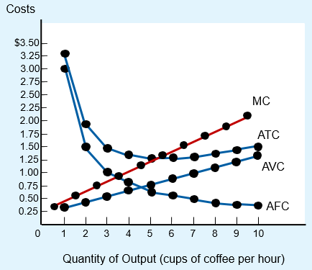
Figure 4 Conrad’s Average-Cost and Marginal-Cost Curves
This figure shows the average total cost (ATC), average fixed cost (AFC), average variable cost (AVC), and marginal cost (MC) for Conrad’s Coffee Shop.
All of these curves are obtained by graphing the data in Table 2. These cost curves show three common features:
Marginal cost rises with the quantity of output.
The average-total-cost curve is U-shaped.
The marginal-cost curve crosses the average-total-cost curve at the minimum of average total cost.

Slide 23
The Various Measures of Cost, Part 7
Typical cost curves
Marginal cost eventually rises with the quantity of output
Average-total-cost curve is U-shaped
Marginal-cost curve crosses the average-total-cost curve at the minimum of average total cost

Slide 24
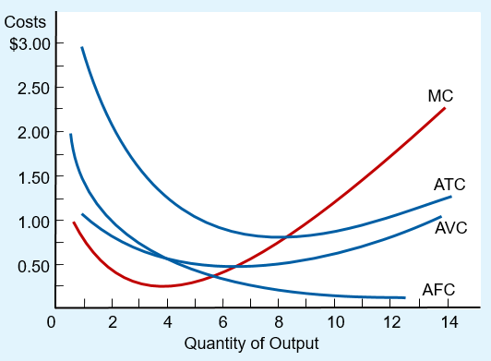
Figure 5 Cost Curves for a Typical Firm
Many firms experience increasing marginal product before diminishing marginal product. As a result, they have cost curves shaped like those in this figure. Notice that marginal cost and average variable cost fall for a while before starting to rise.

Slide 25
Costs in Short and Long Run, Part 1
Many decisions
Fixed in the short run
Variable in the long run
Firms – greater flexibility in the long-run
Long-run cost curves
Differ from short-run cost curves
Much flatter than short-run cost curves
Short-run cost curves
Lie on or above the long-run cost curves

Slide 26
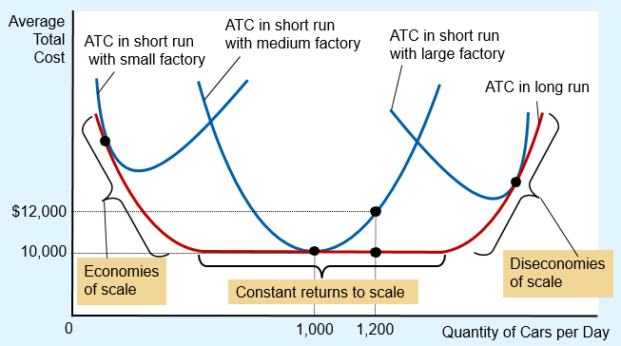
Figure 6 Average Total Cost in Short & Long Runs
Because fixed costs are variable in the long run, the average-total-cost curve in the short run differs from the average-total-cost curve in the long run

Slide 27
Costs in Short and Long Run, Part 2
Economies of scale
Long-run average total cost falls as the quantity of output increases
Increasing specialization among workers
Constant returns to scale
Long-run average total cost stays the same as the quantity of output changes

Slide 28
Costs in Short and Long Run, Part 3
Diseconomies of scale
Long-run average total cost rises as the quantity of output increases
Increasing coordination problems

Slide 29
Table 3 The Many Types of Cost: A Summary
Term | Definition | Mathematical Description
Explicit costs | Costs that require an outlay of money by the firm | Empty cell
Implicit costs | Costs that do not require an outlay of money by the firm | Empty cell
Fixed costs | Costs that do not vary with the quantity of output produced | FC
Variable costs | Costs that vary with the quantity of output produced | VC
Total cost | The market value of all the inputs that a firm uses in production | TC = FC + VC
Average fixed cost | Fixed cost divided by the quantity of output | AFC = FC / Q
Average variable cost | Variable cost divided by the quantity of output | AVC = VC / Q
Average total cost | Total cost divided by the quantity of output | ATC = TC / Q
Marginal cost | The increase in total cost that arises from an extra unit of production | MC = ΔTC / ΔQ

